Slide 1


GreenCircle Certified Database Project
Project Status and Timeline Updates

Slide 2
Project Timeline Updates
Tasks | Timeline
Week Start Date | 7/7 | 7/14 | 7/21 | 7/28 | 8/4 | 8/11 | 8/18 | 8/25 | 9/1 | 9/8 | 9/15 | 9/22 | 9/29 | 10/6 | 10/13 | 10/20
Week End Date | 7/11 | 7/18 | 7/25 | 8/1 | 8/8 | 8/15 | 8/22 | 8/29 | 9/5 | 9/12 | 9/19 | 9/26 | 10/3 | 10/10 | 10/17 | 10/25
Requirements & Wireframes
Front-end Design
Architecture / Environment Setup
Database Expansion
API Development & Backend
Front-end Development
Business Acceptance Testing
Deployment & Configuration
Documentation
Milestones:
7/11 – Wireframes & Requirement complete
9/12 – Development Complete, Unit and Integration Testing complete
10/10 – Testing Complete
10/17 – Go live
Coordination:
9/17 – 10/10 : Business Acceptance Testing, Defect Resolution
9/29 – 10/10 : API Testing with Amazon
9/22 – 10/3 : Deployment Activities, Data Migration

Slide 3
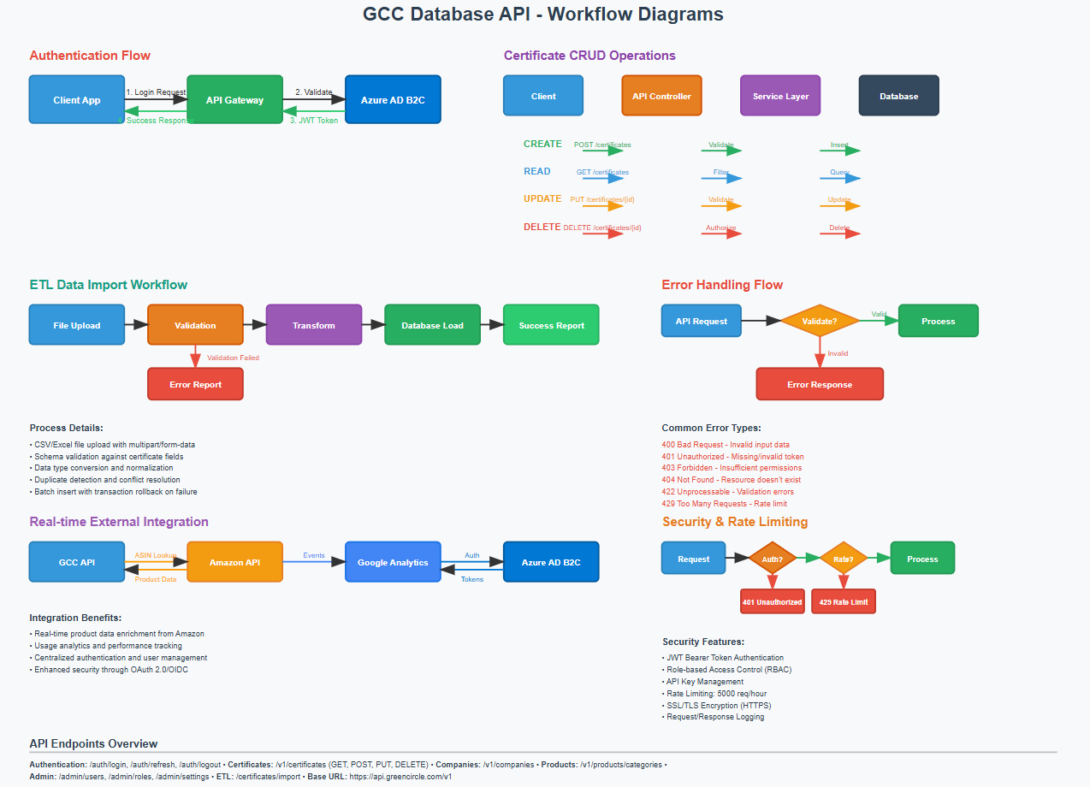
API Documentation
Notes:
API_Workflow_Diagrams.svg

Slide 4
API – Phase 2
Phase 2 Expansion Estimate: Adding Wayfair + 1 More Partner
📅 Timeline: 6-8 weeks
💰 Cost: ~$35,000
👥 Team: 1 Senior Dev, 1 Junior Dev, QA, DevOps
Key Deliverables:
1. Partner Abstraction Framework - Reusable architecture
2. Wayfair Integration - Custom endpoints & field mapping
3. Generic Partner Template - Quick onboarding for future partners
4. Admin Interface - Configure partners without code changes
5. Enhanced Monitoring - Partner-specific metrics & rate limiting
---
Recommended Architecture:
- Partner-Specific Routes: /api/partners/amazon/*, /api/partners/wayfair/*
- Abstraction Layer: IPartnerService with implementations per partner
- Configuration-Driven: Partner settings in JSON, not hardcoded
- Scalable Design: Add new partners in 1-2 weeks each
---
Business Impact:
- Current: Amazon integration supports single partner
- Phase 2: Framework supports unlimited partners
- ROI: First additional partner costs $35K, subsequent partners ~$5-10K each
- Timeline: Wayfair could be live by Q1 2026
The existing codebase provides a solid foundation. The main effort is
creating the partner abstraction layer and configuration system, not
rebuilding the API from scratch. This approach balances speed-to-market with
long-term scalability.

Slide 5
Test Data?
What test data is needed for UAT Testing?

Slide 6
Readiness Checklist?
What test data is needed for UAT Testing?

Slide 7
Development Progress:
0_Documentation/docs/SQL-Server-Setup-and-2FA-Analysis.md
2FA Analysis Results
Current Status: The 2FA service is well-implemented but needs integration completion.
What's Working:
- ✅ Secure 6-digit code generation
- ✅ 5-minute expiration
- ✅ Email delivery with HTML templates
- ✅ Rate limiting (3 attempts)
- ✅ Resend functionality
Critical Gaps:
- ❌ Not enforced in login flow
- ❌ No recovery codes
- ❌ Missing database audit trail
- ❌ No SMS option
Next Steps:
1. Week 1: Complete login integration and add 2FA setup page
2. Week 2: Implement recovery codes and audit logging
3. Week 3: Add SMS and authenticator app support

Slide 8
Test Case Coverage

Slide 9
Requirements, User Stories, User Journeys, Epics Metrics
Business Acceptance Criteria
System Acceptance Criteria

Slide 10
Test Execution Results
Unit Testing
Integration Testing
Provide overview of additional Automated Test Suites
Provide export of test cases that can be used for UAT testing.
  Provide the traceability to requirements

Slide 11
August Overview
Development of the system is progressing well.
  85% done with the development
Continuing to work on the Deployment and Data Migration Plan.

Slide 12
August Overview – Next Steps
Configure production environment
SSL certs + domain setup
Load balancer + scaling configuration
Final UAT & bug fixes
Performance testing under load
Final documentation + training deliverables

Slide 13
August Overview – Open Items
Tracking Defects
Identifying missing requirements or use cases
Documenting Process flows, User Journeys
Documenting Technical Architecture and Design Document.
API Specifications and

Slide 14
August Overview - Reports
Architecture
SAD
User Flows
API Data Flow
ERD Core Entities
Security Flow
Integration Diagram
Database Schema
Comprehensive Test Scenarios Analysis.md
Test Execution Results Analysis
Deployment and Data Migration Plan
2FA Setup Guide
Docker deployment guide
Plesk deployment guide
Hosting in Production? Will it be on our servers, the Plesk Server?

Slide 15
Scope Creep Analysis & Timeline Impact
Metric | Original | Revised | Increase
Timeline | 14–18 weeks | 34–40 weeks | +20–22 weeks
I had a family emergency that reduced my commitment to the project for a few weeks.
The increased scope from the initial proposal with the additional enhancements has impacted the original timeline.
The timeline reflects an accurate schedule to ensure quality and fits to the business needs of the system.
Area | Description
Client Requirements | User stories and requirements evolved during design.
Front-End Redesign | Expanded from basic UI to extensive front-end design
Product Management | Introduced multi-ID types (ASIN, UPC, GTIN, EAN) and import features.
Field Management | Included inline editing and dynamic field creation.
Dashboards | Added 10+ metrics, tracking, and role-based views.
Stakeholder Feedback | Multiple rounds of design revisions required.

Slide 16


GreenCircle Certified Database Site Map
Notes:
CRUD: [Create, Read, Update, Delete] – Wireframes include the details of the screens.
Notifications & Alerts: Color-coded: Green for success, Red for errors, Yellow for warnings, Blue/gray for info)
Sign-up Registration will be included but hidden and disabled for all users except the admin.
Assumptions:
Certificate List 1.0 is a different page than Certificates 3.0.
Admin will have the ability to Add, Edit or Delete a Certificate, Company, Products, Users, Certificate Type, Product Types and Tags.
Notes:
Comments:
S2:
See comment on page 46 may need these pages to edit/delete Product Name or Company Name records unless you can find another way
How do you add a new field. Not represented anywhere.
Remove (Roles) from site map.
Is there an API page – or is that all backend?
7.1.3 – see comments in section
Are you accounting for non-phase 1 on purpose? No this was missed when updating the documents.
Grayed Items: Some were intentionally removing.
3.3 – This would be clients and partners
There needs to be interface for the Analyst to be able to add and edit new Product (and associate product category/type to it) and Company. Current DB has this happening in the Cert upload interface and separate pages.

Slide 17
Out of Scope Items – Initial Design Phase
The following items are not included in the current scope and will be considered for future phases:
  New Feature Requests Post-Freeze : Any new functionality or UX suggestions will be reviewed separately post-launch
  Non-Core Page Redesigns: Pages not directly tied to core certificate workflows (e.g., user management, admin dashboards) are not part of the initial design scope.
  Advanced Reporting & Analytics Modules: Custom reporting or dashboards requiring dynamic visualizations will be addressed in a future release.
  Undocumented Features – Anything not captured in this document or related requirement files is excluded.
  Integration Beyond Amazon Export: Any third-party system integration beyond current export scope will be handled as a separate project.
  Clone Functionality – Selective field cloning for certificate records is not included.
  Notifications & Alerts – Real-time user notifications are not part of this phase.
  Undocumented Features – Anything not captured in this document or related requirement files is excluded
Note: Any additional functionality or enhancements outside this scope will follow the formal change request process and may be included in a post-launch roadmap.

Slide 18
October 17th Go-live
The adjusted timeline provides:
  Adequate time for comprehensive development of expanded features
  Proper testing cycles for the enhanced functionality
  Quality assurance for the more complex integrations
  Stakeholder alignment on enhanced deliverables
Scope Evolution Highlights:
  Enhanced Security Features - MFA, audit logging, role-based permissions
  Advanced User Experience - Infinite scrolling, improved filtering, mobile considerations
  Complex Data Management - Sophisticated product ID handling, multi-partner associations
  Extended User Types - External partners, varied client access models

Slide 19
Design Revision Impact on Delivery
Multiple UI design paths were explored throughout the project
Functionality appeared inconsistently across versions (e.g., filters/buttons in some screens but missing in others)
Comments and revisions introduced fragmentation and slowed alignment
Final design direction is now established, but required more time than originally scoped
Incremental requirements were introduced with additional scope delivered in fragments.
As new features were added mid-cycle, screens often showed inconsistent functionality.
Each revision improved the system but fragmented design artifacts and slowed decisions.
We are now consolidating all approved elements into a single UI reference to avoid rework.
This will improve quality, reduce QA cycles, and streamline final delivery.

Slide 20
Final Design Consolidation - Scope Locked
Scope Freeze: No new functionality will be added. Existing design elements are being unified into one master reference.
Fragmented Pages: Screens created during iterative revisions are being merged to ensure every approved feature appears consistently.
Quality Focus: Consolidation eliminates hidden gaps, reduces rework, and accelerates the build and QA phases.
Post-Launch Enhancements: Any new ideas identified after consolidation will be scheduled for a future release cycle.

Slide 21
Managing Scope and Change Control Plan
Purpose: Structure future requests to maintain control over budget and timelines.
Baseline Locked: the consolidated design is the development baseline.
Transparency: All new requests will be assessed and estimated before inclusion.
No Hidden Drift: Unapproved additions will be deferred to a future release phase.
Process includes request intake, impact review, client approval, and timeline update.
Future changes will follow a simple estimate-and-approve process.
Any additions will be reviewed for:
  Timeline impact
  Cost implication
  System stability
This ensures transparency and avoids unintentional delays during final phases.

Slide 22
Appendix
Requirements, User Stories, Process Flows, Architecture,

Slide 23
Data Migration Plan
## Executive Summary
We are pleased to present our comprehensive data migration strategy for the GreenCircle Certified (GCC) Database Solution. Our approach ensures a seamless transition from your current certificate management system to the new ASP.NET Core platform with zero data loss, minimal business disruption, and enhanced operational capabilities.
### Key Deliverables
- **Migration Window:** Less than 4 hours of system downtime
- **Data Integrity:** 99.99% accuracy guarantee with comprehensive validation
- **Risk Mitigation:** Multi-layered backup and rollback procedures
- **Business Continuity:** Phased approach ensuring operational stability
- **Post-Migration Support:** 30-day intensive support period
### Strategic Benefits
- **Reduced Operational Risk:** Proven migration methodology with automated validation
- **Enhanced Data Quality:** Built-in cleansing and standardization processes
- **Improved Compliance:** Complete audit trail and regulatory alignment
- **Future Scalability:** Architecture supporting 10x growth capacity

Slide 24
Architecture
a

Slide 25
A
a

Slide 26
A
a

Slide 27
A
a

Slide 28
A
a

Slide 29
A
a

Slide 30
A
a

Slide 31
A
a

